Slide 1
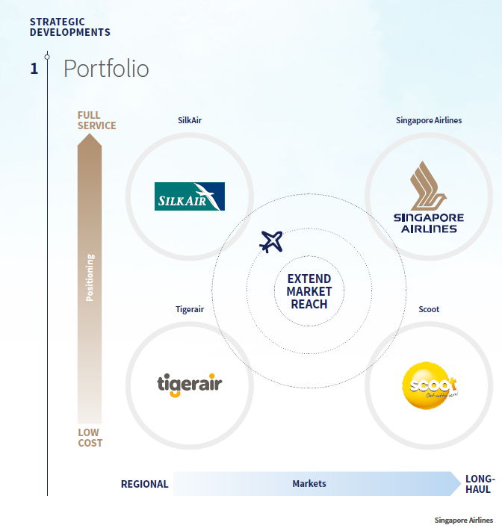
"As the SIA Group moves towards a new phase of growth across all airlines in the Group, our fleet and network continue to expand in support of our portfolio strategy. With both full-service and low-cost airline investments, we remain committed to short-, medium- and long-haul markets with our portfolio of airlines.
The SIA Group continues to place emphasis on the need to adapt nimbly and flexibly to industry changes, so as to stay relevant in the competitive environment as we step up in the next phase of our growth. During the new financial year, Scoot and Tigerair will be merging under the Scoot brand name.
——Quote from SINGAPORE
AIRLINES Annual Report FY2016/17

Slide 2
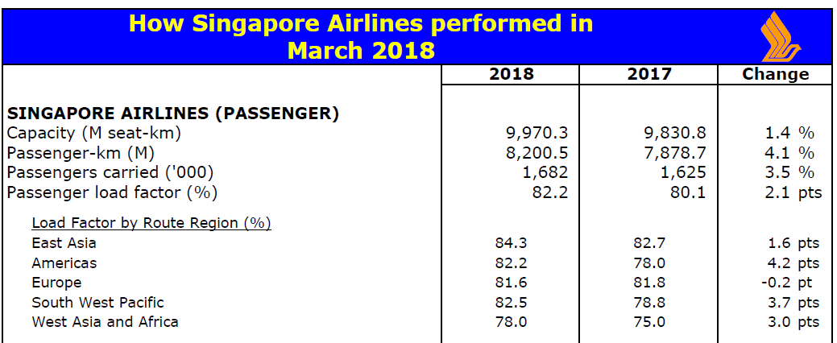
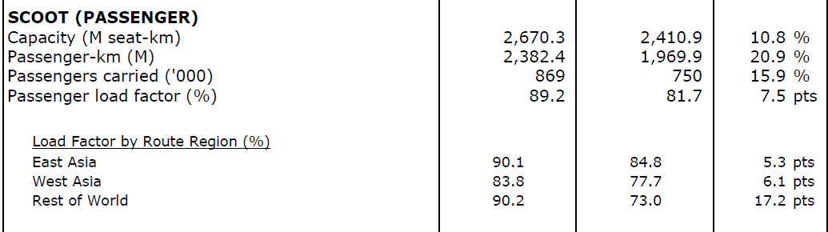
Singapore Airline’s growth is stable. The annual change is around 2~3 %.
Scoot is now fast growing and developing quite quickly.
Due to the price comparative advantage, the load factor is impressively high.
Selected routes to India, South East Asia , China, Australia, and fifth freedom routes to North Asia and America continued to improve.
Source: MARCH 2018 OPERATING RESULTS

Slide 3
